Slide 1
Systems of Equations Applications

Slide 2
Steps to Solve
Define the variables (ask yourself what am I looking for in this problem?
Write the two systems of equations
Solve the problem using the method of your choice (graphing, elimination, and substitution)
Explain your answer and check it to make sure the answer makes sense.

Slide 3
Bob purchases 100 pens and 200 pencils for $125. Grant purchases 500 pens and 200 pencils for $425. How much does each pen and pencil cost?

Slide 4
The sum of two numbers is 13. Their difference is -3. Find the two numbers.

Slide 5
A piggy bank has 16 coins of quarters and nickels. The value of the bank is $2.20. How many of each coin is in the bank?

Slide 6
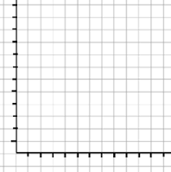
Bike rental company #1 charges $1 per hour and an $8 initial fee. Company #2 charges $2 per hour and a $6 initial fee. When do both companies charge the same and when is one company better to use than the other?

