Slide 1
Midpoint and Distance Formulas

Slide 2
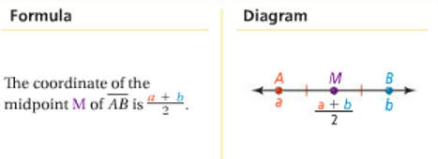
Midpoint Formula
On a number line
The coordinate of the midpoint is the _____________ or _____________ of the coordinates of the endpoints.

Slide 3
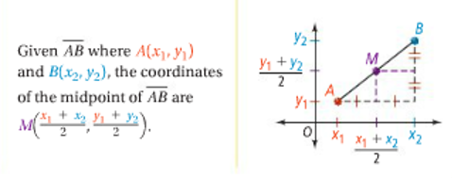
Midpoint Formula
In the Coordinate Plane
The coordinates of the midpoint are the average of the x-coordinates and the average of the y-coordinates of the endpoints.

Slide 4
Example: Finding the Midpoint
Segment AB has endpoints at -4 and 9. What is the coordinate of its midpoint?

Slide 5
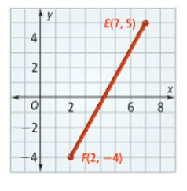
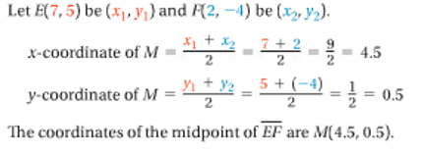
Example: Finding the Midpoint
Segment EF has endpoints E(7,5) and F(2,-4). What are the coordinates of its midpoint M?

Slide 6
Segment Bisector
Definition: Any segment, line or plane that divides a segment into two congruent parts is called a segment bisector.

Slide 7
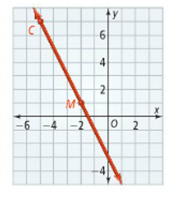
Finding an Endpoint
The midpoint of segment CD is M(-2,1). One endpoint is C(-5,7). What are the coordinates of the other endpoint D?

Slide 8
Distance Formula

Slide 9
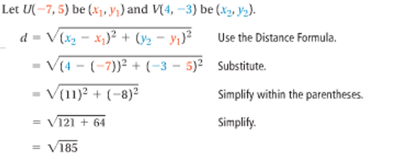
Example: Finding Distance
What is the distance between U(-7,5) and V(4,-3)?

Slide 10
Practice
Find the distance and midpoint between (4,-5) and (3,-5).
Find the distance and midpoint between (8,4) and (3,-2).

