Slide 1
Graphing Quadratic Equations
Lesson 6.1-6.2

Slide 2
Graphing Quadratic Equations: Standard Form of a Quadratic Equation
Standard form- any function that can be written in the form
  f(x) = ax² + bx + c where a ≠ 0
You can find information about the quadratic function from the coefficients a, b, and c.

Slide 3
Labels for a Quadratic Graph
The quadratic graph is called a ________________.
Roots, zeros, x-intercepts or solutions where the graph intersect the x-axis or the value of x when y = 0.
Axis of symmetry: the line that divides the graph in ½.
Vertex- the minimum or maximum coordinate point of the graph.

Slide 4
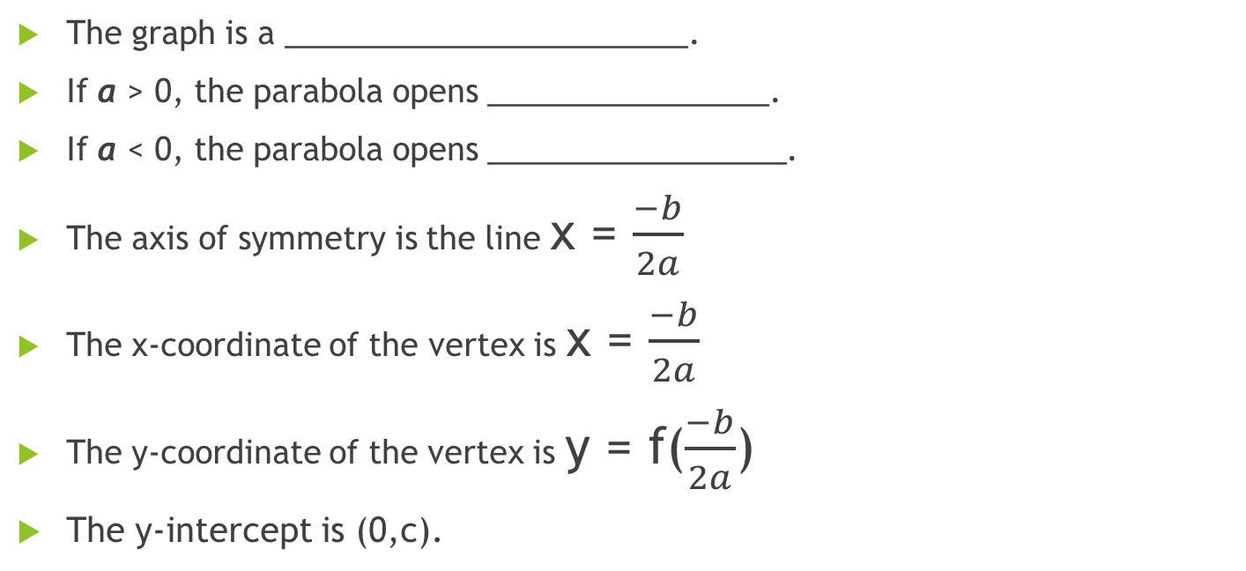
Properties of Quadratics in Standard Form
The graph is a _______________________.
If a > 0, the parabola opens ________________.
If a < 0, the parabola opens _________________.
The axis of symmetry is the line x = $\frac{−b}{2a}$
The x-coordinate of the vertex is x = $\frac{−b}{2a}$
The y-coordinate of the vertex is y = f($\frac{−b}{2a}$)
The y-intercept is (0,c).

Slide 5
Quadratic Solutions
The number of real solutions is at most two.
No Solutions One Solution Two Solutions

Slide 6
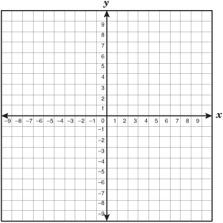
Example 1: y = -3x² – 6x + 8
Vertex:
Axis of Symmetry:
Roots/Solutions:
Y-intercept
Minimum or Maximum: Value:
x | y

Slide 7
Example 2: y = x²-4x+1
x | y
Opens how?
Axis of symmetry:
Vertex:
Y-intercept:
Roots/Solutions:
Max or min? Value:

Slide 8
Example 3: Graph y = -x²-2x+3
Axis of symmetry:
Vertex:
Roots/Solutions:
Y-intercept:
Min or max? Value:
x | y

Slide 9
Example 4: Graph y = x² – x – 6
Axis of symmetry:
Vertex:
Roots/Solutions:
Y-intercept:
Max/min? Value:
x | y

Slide 10
Ticket out the Door:
On the post-it provided to you, rate yourself 1-3 on the following statements. Remember: 1 means I’m still not understanding, 2- with a little more practice I will have it, 3- I am good to go.
  I can identify the vertex, axis of symmetry, and y-intercepts of a quadratic equation.
  I can determine whether the equation has a maximum or minimum and find its value.
  I can graph a given quadratic equation by hand.
  I can graph a given quadratic equation using my calculator and know how to find the needed information from the table.

