Slide 1
Welcome Back, Mustangs!
Here’s your first test of the year!
Look for your name on the seating chart and find your seat. Don’t worry if you don’t like your spot…you won’t spend a lot of time here!

Slide 2
Agenda
Warm-up: Math Expressions “About Me”
Hand out syllabus
Stations
Ticket Out the Door: #Mathis

Slide 3
Ticket Out the Door
Use the slip of paper given to you to complete the tweet.
#Mathis __________________
Remember to keep it short and sweet!
Turn it in to the bucket when finished.

Slide 4
Day 2
Make sure you grab a card from me if you haven’t already. Work to find the person that has the match to yours. They will be your partner for our first activity today. Sit in your assigned seat until I tell you to meet with them.
Have out your questionnaire from yesterday’s warm-up.

Slide 5
Warm-up: Fast 5
Take 5 minutes to get to know your partner and share with them some of the information on your sheet from yesterday. Be prepared to share some things with the class when time is up!

Slide 6
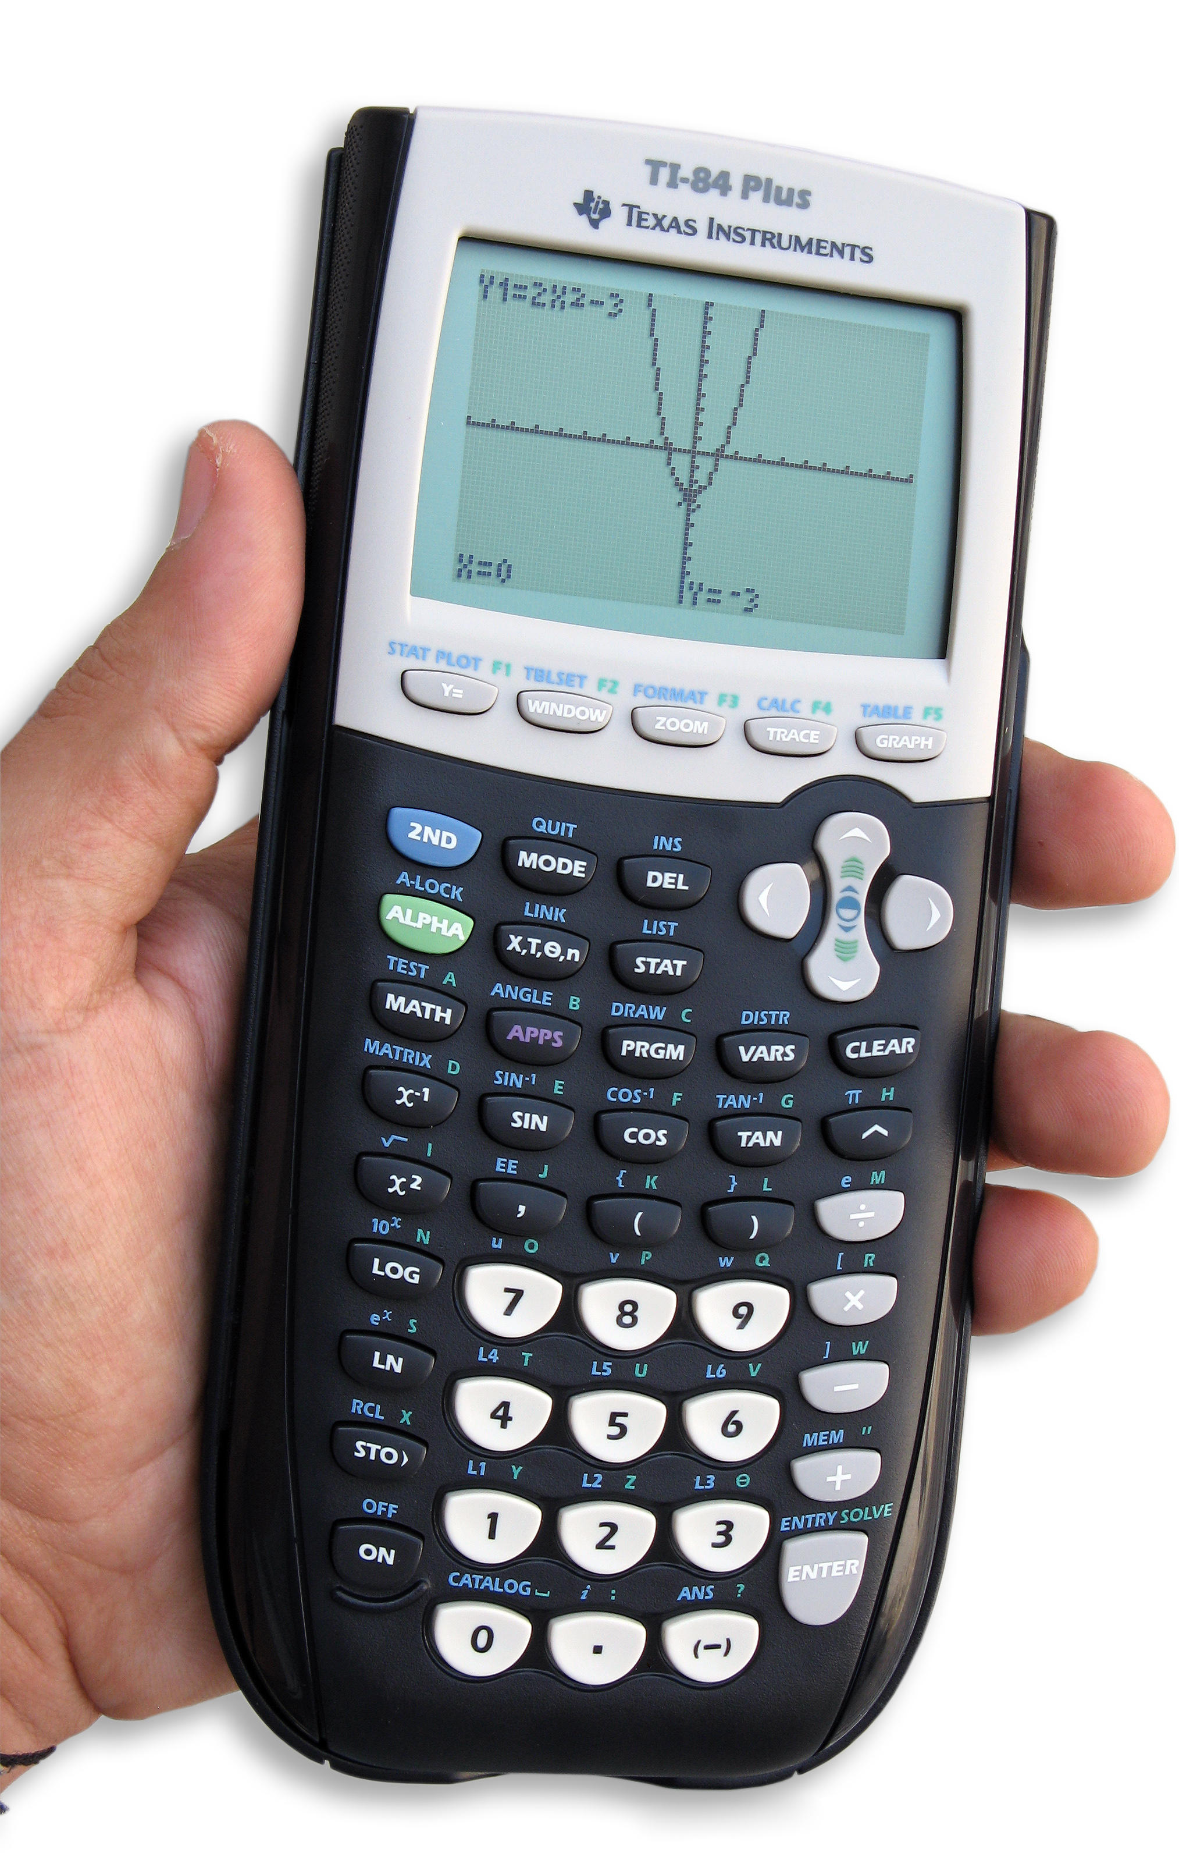
Review and Recap: Syllabus Highlights
Supplies- make sure you have them by Monday!

Slide 7
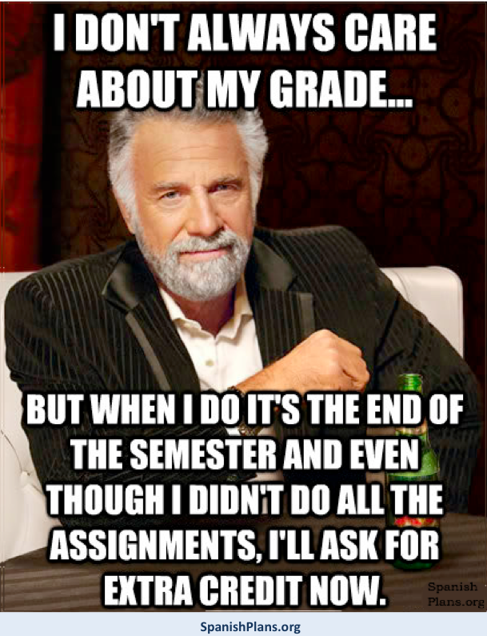
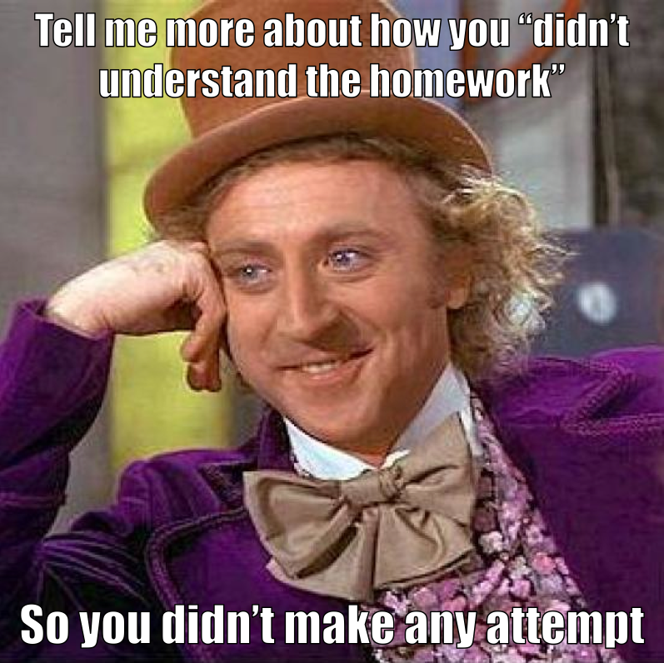
Syllabus Highlights: Geometry Grading
Daily Work- 10%
Quizzes- 20%
Tests- 50%
Midterm- 5%
Final Exam- 15%

Slide 8
Syllabus Highlights: Algebra 2 Grading
Daily Work- 10%
Quizzes- 25%
Tests- 50%
Midterm- 5%
Final (EOC)- 10%

Slide 9
Syllabus Highlights: Test Prep
Take notes.
Practice, practice, practice!
Do the test reviews given to you…and then check them to make sure you have the correct answers!

Slide 10
Syllabus Highlights: Test Retakes
Done within 1 WEEK of receiving your original test grade
Must attend a tutoring session
Individual practice done and turned in on day of retake
****Scores will be averaged!****

Slide 11
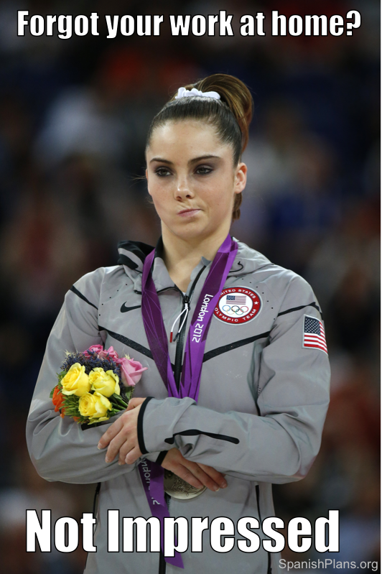
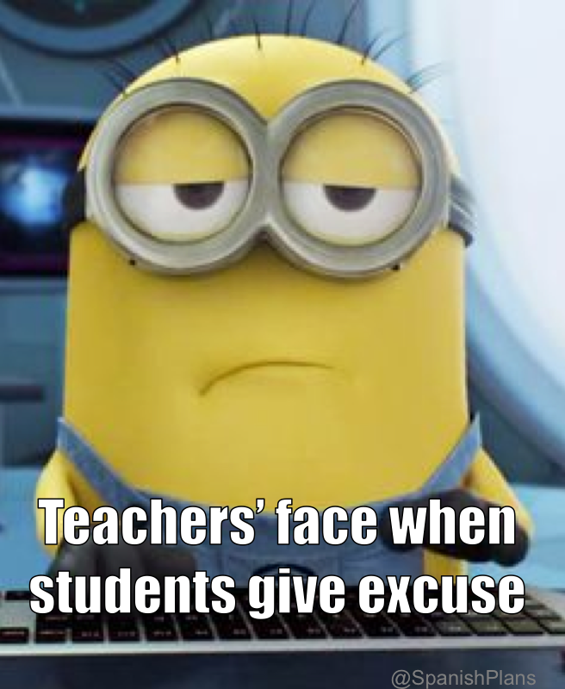
Syllabus Highlights: Make-up Work
Only if you are ABSENT.
Number of days you missed plus one for any assignments or assessments

Slide 12
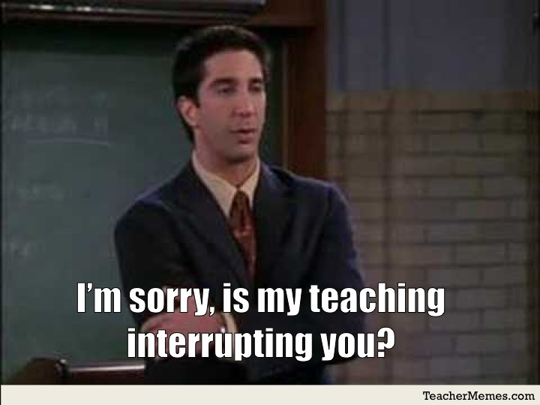
Classroom Expectations: Be Prompt/Punctual
Be in your assigned seat when the bell rings.

Slide 13
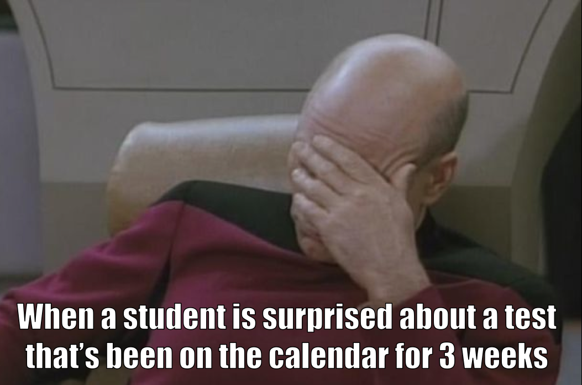
Classroom Expectations: Be Prepared
Know your schedule and assignments.
Bring all your materials.

Slide 14
Classroom Expectations: Be Productive
You complain about homework but when I give you time to work in class you just socialize
Actively participate and use your time wisely!

Slide 15
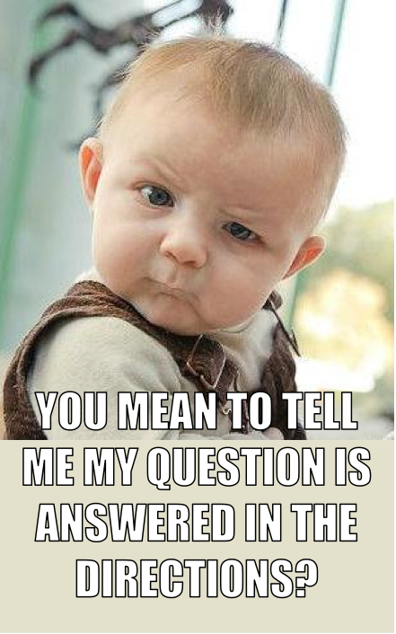
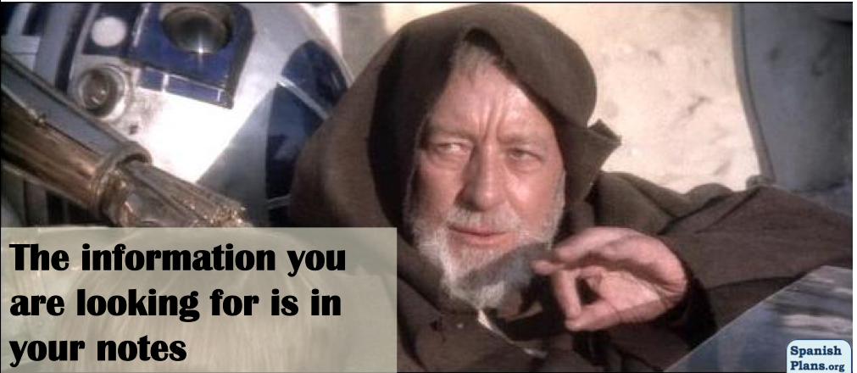
Classroom Expectations: Be Positive
Don’t give up! Most of the time it’s easier than you think!
Your attitude determines your altitude.

Slide 16
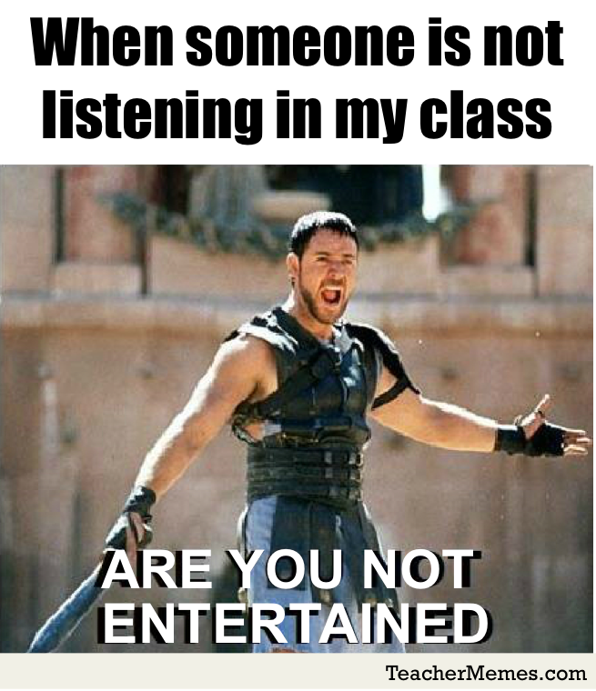
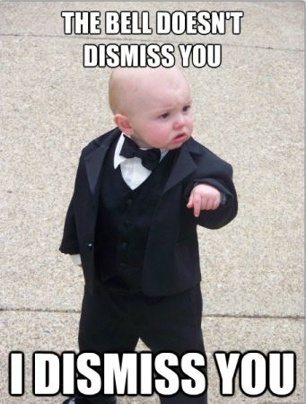
Classroom Expectations: Be Polite
… to EVERYONE.
Respect all expectations.

Slide 17
Reminder to Remind: Honors Algebra 2
Remind Registration- Text 810-10
1st period: @murt1st
6th period: @murt6th

Slide 18
Reminder to Remind: Honors Geometry
Remind Registration- Text 810-10
2nd period: @murt2nd
4th period: @murt4th

Slide 19
Reminder to Remind: Algebra 2
Remind Registration- Text 810-10
@murt5th

Slide 20
Activity
Gather materials for your group and listen for instructions!

Slide 21
Ticket Out the Door
Complete the half sheet given to you on solving equations. Turn in to the bucket when finished.

