Slide 1
Dividing Polynomials
Long Division

Slide 2

Set Up Long Division
Example 1: $(x^{2}+7x−30)÷(x−3)$
What you are dividing What you are
by goes on the outside dividing into goes on the inside
$$x−3$$
$$x^{2}+7x−30$$

Slide 3
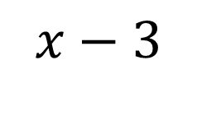
$$x−3$$
$$x^{2}+7x−30$$
Look at the first two terms:
What times $x$ is $x2$

Slide 4
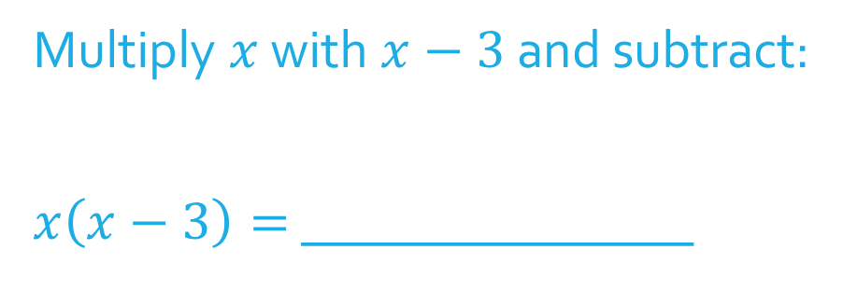

$$x$$
$$x−3$$
$$x^{2}+7x−30$$
Multiply $x$ with $x−3$ and subtract:
$x\left(x−3\right)=$ _______________

Slide 5
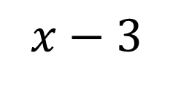
$$x$$
Subtract like terms and bring down the $−30$.
Repeat the process
What times $x$ is $10x$?
$$x−3$$
$$x^{2}+7x−30$$
$$−\left(x^{2}−3x\right)$$

Slide 6

$$x+10$$
Multiply $10$ with $x−3$ and subtract
$$10\left(x−3\right)=$$
$$x−3$$
$$x^{2}+7x−30$$
$$−\left(x^{2}−3x\right)$$
$$10x−30$$
$$−\left( \right)$$

Slide 7

This means that:
$\left(x^{2}+7x−30\right)÷\left(x−3\right)=$

Slide 8
Example 2: $\frac{x^{2}+4x+1}{x−2}$
This time there is a remainder of
The remainder goes over the divisor, $x−2$.

Slide 9
Example 3: $\frac{2x^{3}+7x^{2}+2x+9}{2x+3}$

Slide 10
Example 4: ($3x^{4}−12x+5)÷(x+1)$

