Slide 1
Dividing & Solving Equations With Complex Numbers

Slide 2
Dividing With Complex Numbers
When simplifying expressions with complex numbers, never have an imaginary number in the denominator. We use the conjugate to eliminate our complex number in the denominator.
Find the conjugate for the following:
A) 5i
B) -8i
C) 4 + 3i
D) 5 – 7i

Slide 3

Divide the following:
Together: Try These:
A) $\frac{4}{3i}$ C) $\frac{−3}{−7i}$
B) $\frac{3+i}{−2i}$ D) $\frac{−2−7i}{−5i}$

Slide 4
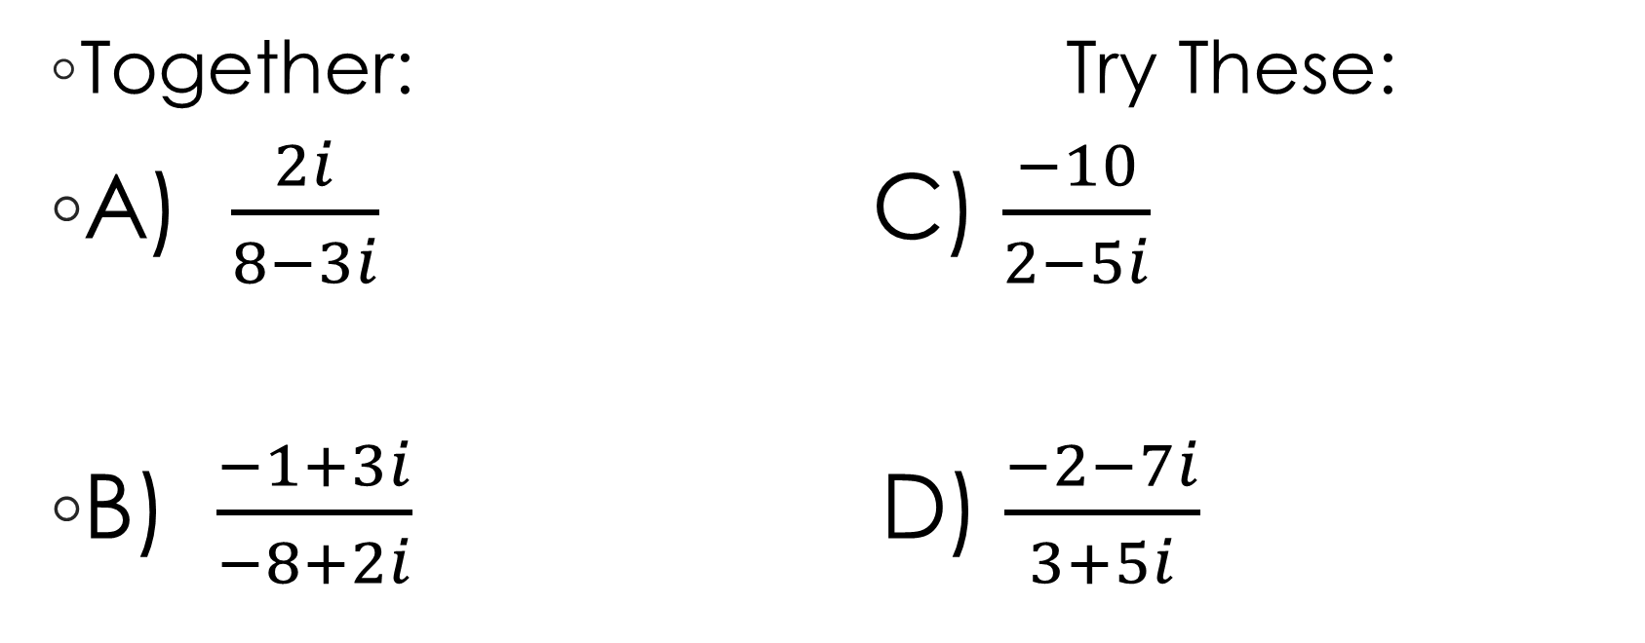
Divide the following:
Together: Try These:
A) $\frac{2i}{8−3i}$ C) $\frac{−10}{2−5i}$
B) $\frac{−1+3i}{−8+2i}$ D) $\frac{−2−7i}{3+5i}$

Slide 5
Solve Equations Using Complex Numbers
Together:
A) 5x² + 45 = 0 B) 4x² + 24 = 0 C) -9x² = 9

Slide 6
Solve Equations Using Complex Numbers
Try These:
D) 9x² + 81 = 0 E) 6x² + 48 = 0 F) -3x² = 81

